Slide 1
A review of Machine Learning
Deep Learning-Odd Sem (2025)
-Dr. Prateek Pandey

Slide 2
Machine Learning Definition
Machine learning is using algorithms to extract information from raw data and represent it in some type of model. We use this model to infer things about other data we have not yet modeled.
Neural networks are one type of model for machine learning.
The field of study that gives computers the ability to learn without being explicitly programmed-Arthur Samuel

Slide 3
The relationship between AI and DL
AI
ML
DL

Slide 4
Scalars, Vectors, Matrices and Tensors
Scalars → Elements in a vector
Vector → an array of n numbers called ‘elements’ or ‘scalars’.
x=[x1, x2, x3, …]
Vectors also represent points in space.
Matrix →a group of vectors, all have the same dimension. E.g. 3x3 matrix.
Tensors → An ‘n’ dimensional array. More general than a vector. It has a rank. Rank 0=scalar. Rank 1 = Vector, Rank 2= Matrix, Rank 3 or more = Tensor.

Slide 5
Hyperplane
A hyperplane is a subspace of one-dimension less than its ambient space.
In a 3-dimension space, a hyperplane would have 2 dimensions.
In a 2D space, a hyperplane will have 1-D.
A hyperplane is a mathematical construct that divides an n-dimensional space into separate parts, and therefore is useful in applications like classification.

Slide 6
Linear Algebra Operations
Dot Product: [1, 2, 3] . [1, 2, 3] = 1x1 + 2x2 + 3x3 = 14 (results in a value)
Application: cosine similarity
Element-wise product or Hadamard product: takes 2 vectors of the same length and produce a vector of the same length.
[1, 2, 3] ⊙ [1, 2, 3] = [1.1, 2.2, 3.3] = [1, 4, 9]
Application: LSTM, Transformers
Tensor Product (Outer product): [1, 2, 3]^{T} ⊗ [4, 5] = [1.4 1.5]
[2.4 2.5 ]
[ 3.4 3.5]_{3x2}
Application: combining text and image, audio and video etc. i.e. fusing representations from different modalities.

Slide 7
Learning Algorithm
Entire procedure by which an ML model:
selects a hypothesis function (y=mx+c)
measures its performance using a cost function (MSE)
updates parameter to improve performance using an optimization method (GD)

Slide 8
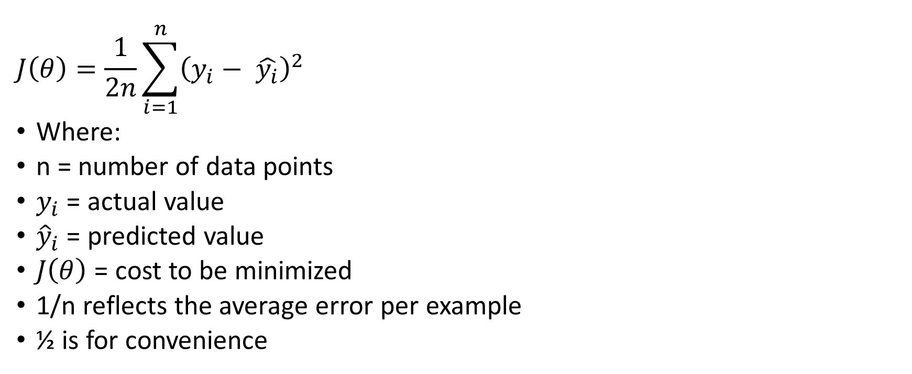
Mean Square Error
$$J\left(θ\right)=\frac{1}{2n}\sum_{i=1}^{n}{{\left(y_{i}− \hat{y_{i}}\right)}^{2}}$$
Where:
n = number of data points
$y_{i}$​ = actual value
${\hat{y}}_{i}$​ = predicted value
$J\left(θ\right)$ = cost to be minimized
1/n reflects the average error per example
½ is for convenience

Slide 9
Training, Testing and Validation
The dataset is split into three parts to evaluate and build reliable models.
Training (60-80%) Validation (10-20%) Testing (10-20%)
Training for learning parameters- a student learning from notes
Validation for hyperparameter tuning or
monitor overfitting
helps decide when to stop training
evaluate performance after each epoch
Mock tests
Testing- the real test-final exams

Slide 10
Resampling Methods
Bootstrapping- Drawing random samples from another sample to generate a new sample that has a balance between the number of samples per class (this is called oversampling, which actually is a specific form of Bootstrapping).
Useful when we model against a dataset with highly unbalanced classes or the dataset is small.
You have quiz scores of 4 students: Data: [60, 70, 80, 90]
Generating 3 bootstrap samples (with replacement), each of size 4.
Original Mean=(60+70+80+90)/4​=75
Sample No. | Sample (drawn with replacement) | Mean
1 | [70, 80, 80, 90] | 80
2 | [60, 60, 70, 90] | 70
3 | [70, 70, 70, 70] | 70

Slide 11
…Resampling Method
Bootstrap Mean=(80+70+70​)/3=73.33
For 3 samples: just report min and max of the bootstrap means: [70, 80]→ Confidence Interval (Estimating uncertainty)
What happens if we draw hundred samples instead of 3?
Cross Validation- powerful technique to assess how well a model generalizes to the unseen data.
Divide your dataset into k portions (folds or splits). Train on k-1 folds and test of kth fold. Repeat this procedure k times. Compute the mean of MSEs obtained after testing the model on each of the k folds.
Why not just a single train-test split?
It depends too much on that one split.
Small datasets make this worse.
Notes:
Ans: The distribution will be smooth. We could even compute 95% confidence interval, which was not possible with just 3 sample means.

Slide 12
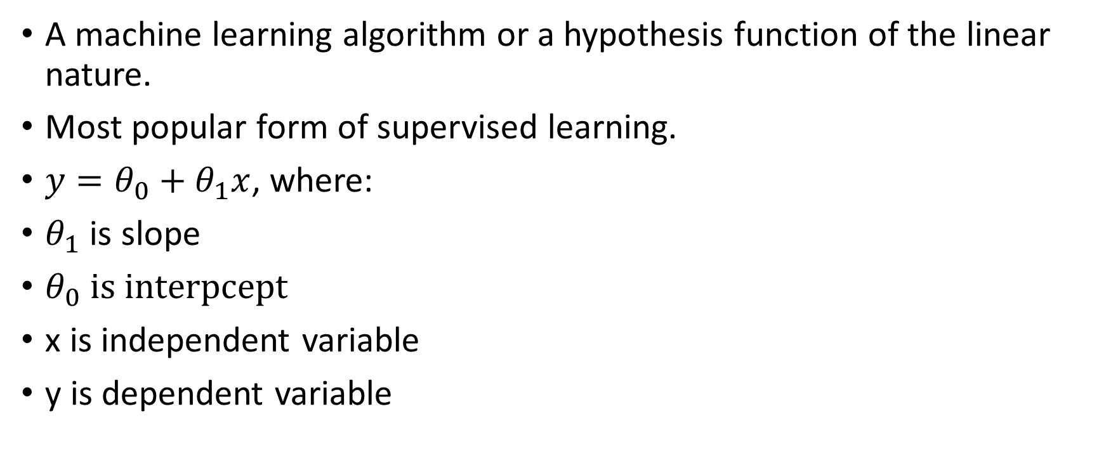
Linear Regression
A machine learning algorithm or a hypothesis function of the linear nature.
Most popular form of supervised learning.
${y=θ}_{0}+θ_{1}x$, where:
$θ_{1}$ is slope
$θ_{0} is interpcept$
x is independent variable
y is dependent variable

Slide 13
How would you fit a line for the given points?
Notes:
Draw a line through the points and show the positive errors and negative errors.
If these errors are summed to get the total error, errors may cancel out each other.
Therefore, square of the errors is taken in count.
A line that passes (or may be not) through these points and yet produces minimum (least) squares of error is called a regression line.
This process of finding the line with least squares (sum) is called method of least square (OLS).
Parameters of regression line can be found out using Normal Equation (or through other optimization techniques like Gradient Descent).
OLS is our cost or objective function that we have to optimize.

Slide 14

Normal Equation
c =$\overline{ y}−m \overline{x}$
m = $\frac{∑x_{i}y_{i} −n. \overline{x}\text{ . }\overline{y}}{∑x_{i}^{2} −n. {\left(\overline{x}\right)}^{2}}$

Slide 15
Problem 1
Consider the following set of points: {(-2 , -1) , (1 , 1) , (3 , 2)} a) Find the least square regression line for the given data points. b) Plot the given points and the regression line in the same rectangular system of axes.
Notes:
sum(x)=2 sum(x^2)=14 sum(y)=2 sum(xy)=9
a=3*9-4/3*14-4=23/38
c=1/3(2-23/38*2)=1/3(2-46/38)=1/3(30/38)=1/3(15/19)=5/19

Slide 16
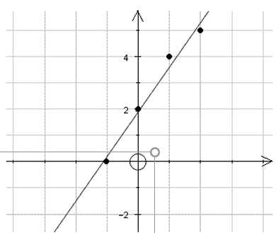
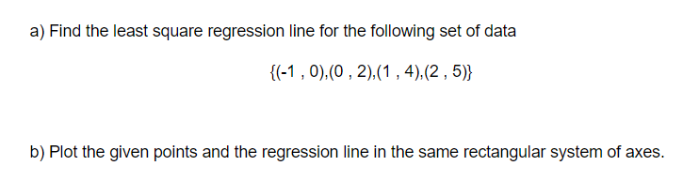
Problem 2
Notes:
a=1.7, b=1.9

Slide 17
Problem 3
Suppose the owner of the garbage truck company is interested in the relationship between the age of a garbage truck and the annual repair expense she should expect to incur. In order to determine this relationship, the owner has accumulated information concerning four of the trucks the city currently owns. What would be the annual maintenance cost of a truck that is 4 years old.
Data-Set | Truck Number | Age of truck in years | Repair Expense during last year in lacs of Rupees (Rs)
Annual Truck Repair Expenses | 101 | 5 | 7
 | 102 | 3 | 7
 | 103 | 3 | 6
 | 104 | 1 | 4
Notes:
Expense=3.75+0.75*Age
6.75 lakh

Slide 18
Logistic Regression

Slide 19
Confusion Matrix

Slide 20
ROC Curve

Slide 21
MSE Decomposition

Slide 22
Bias-Variance Tradeoff

